Slide 1


S Srivatsan
16/01/2025

Slide 2

Outline
Executive Summary
Introduction
Methodology
Results
Conclusion
Appendix

Slide 3
Executive Summary
Summary of methodologies
Summary of all results

Slide 4
Introduction
Project background and context
We are a new Space company called Space Y. We would like to perform Data Science task that can figure out if SpaceX falcon9 rocket will land or not. The data collected contains various features that can help us with the task,
Problems you want to find answers
The problem that we need to find answer for is if a SpaceX falcon9 rocket will land or not.

Slide 5

Section 1

Slide 6
Methodology
Executive Summary
Data collection methodology:
The data required is collected using 2 sources ( SpaceX json Rest api(api.spacexdata.com), Wikipedia )
Perform data wrangling
The data that was extracted is not in the correct format for the prediction. So, we convert categorical data into numerical values using one hot encoding.
Perform exploratory data analysis (EDA) using visualization and SQL
Perform interactive visual analytics using Folium and Plotly Dash
Perform predictive analysis using classification models
We build different machine learning models to perform classification and we use different metrics to find the accuracies of these algorithms,

Slide 7
Data Collection
Data needed for this project is collected from 2 sources.
1. SpaceX Rest Api is used to get data that is available in JSON format.
https://api.spacexdata.com/
The data from SpaceX Rest Api is extracted using the requests module in python to communicate with SpaceX rest api and gets the in the JSON fromat. This data is then converted to a pandas DataFrame and then saved to a csv file.
2. Wikepedia
https://en.wikipedia.org/wiki/List_of_Falcon_9_and_Falcon_Heavy_launches
The data in Wikipedia is a table in a html webpage. To extract this data, we need to use webscraping. First we use the requests module to communicate with Wikipedia to get the response in html format. Then the webscraping is done by using beatiful soup. And then the data is converted into a pandas DataFrame and saved to a csv file.

Slide 8
Data Collection – SpaceX API
The data from SpaceX Rest Api is extracted using the requests module in python to communicate with SpaceX rest api and gets the in the JSON fromat. This data is then converted to a pandas DataFrame by performing json normalization to make sure we do not have any nested data.
Then we select only certain features necessary for the analysis. We also remove all the falcon 1 related rows and only retain falcon 9 rockets
After some more cleanup, we save the data to a csv file.
You can lookat the data collection process in this github link.
SpaceX Rest API
request
response
requests module
json_normallize()
pandas DataFrame
selecting features
and cleaning
Falcon 9 DataFrame
to_csv()
Save to csv

Slide 9
Data Collection - Scraping
The data from Wikipedia is extracted using the Web Scraping using beautiful Soup in python. We first use request to grab the html page. Then we create a beautiful soup object.
We then loop through each row of the 2nd table and get columns that is necessary for us and convert it to a DataFrame
Finally we save the data into a csv file.
You can look at the data collection process in this github link.
Wikipedia
request
response
requests module
response.text
Create soup object
extract each row
of 2nd table
Falcon 9 DataFrame
to_csv()
Save to csv

Slide 10
Data Wrangling
csv data file
We start by reading the data that we stored in the csv file using pd.read_csv(). When we look at the data, we have a few columns have categorical data including the outcome column. Which needs to be changed to numerical values. The independent columns are converted to numerical values after some EDA is finished. For now, we find out how many null values exists in each column and convert the outcome column to numerical values and save it into a new csv file.
You can find the jupyter notebook for the Data Wrangling process in this Github Link
pd.read_csv()
read data to a DataFrame
finding number of null values in each column
Checking Output column to see different success and failure outcomes
Converting them to 0 and 1
to_csv()
Save to csv

Slide 11
EDA with Data Visualization
We start by plotting multiple scatter plots anc catplot to find out relationships between different columns over the class.
- x="FlightNumber", y="PayloadMass", hue="Class"
- x='FlightNumber', y='LaunchSite', hue = 'Class'
- x = 'PayloadMass', y = 'LaunchSite', hue = 'Class'
- x = 'FlightNumber', y = 'Orbit', hue = 'Class'
- x = 'PayloadMass', y = 'Orbit', hue = 'Class',
We then create a bar plot that shows the average success rate for each orbit
We create a line plot between Year of launch vs success rate. This is because we have time series data.
Finally, we perform one hot encoding to convert all the independent columns with categorical data into numerical data.
You can find the jupyter notebook for the EDA with Data Visualization in this Github Link

Slide 12
EDA with SQL
In this section, we will use the sql magic command in jupyter notebook to perform EDA with the data.
We start by reading data from csv and saving it into a database file.
We use different columns to understand different things like total number of times each outcome is occuring, Launch Sites for Failed DroneShip landings, getting booster versions with largest payload mass, date of the first succesful landing, total and average payload masses and much more
We use select commands to grab the data and different concepts like where clauses, group by, sub queries, ordering and aggregate functions to expore data to get useful insights
You can find the jupyter notebook for the SQL EDA in this Github Link

Slide 13
Build an Interactive Map with Folium
In this section we create a USA map and we place markers for the launch sites based on the coordinates. We use different kinds of map objects like circle, marker, marker cluster, PolyLine.
The Marker is used to specify the exact location of an Launch. A LaunchSite can have multiple launch locations.
A Circle object representes the LaunchSite.
A marker cluster clusters the markers and shows how many launch locations are in an area depending on the zoom level.
The PolyLine is a line between two locations. This is used to show the distances between the launch site and nearby places.
You can find the jupyter notebook for the Folium Interactive map in this Github Link

Slide 14
Build a Dashboard with Plotly Dash
In this section we built a plotly dash application. The dash app contains a dropdown and a range slider and 2 graphs.
The dropdown contains options for each LaunchSite. We can also select if we want to display graph for all LaunchSites.
The range slider is to represent payload mass.
The first graph shows pie chart of success rate for the launch site that we lect using the dropdown.
The second graph shows scatter plot of payload Mass vs class. The data is filtered based on the selected LaunchSite from the dropdown and payload mass withing the range selected from the RangeSlider.
You can find the python file for the Plotly Dash App in this Github Link

Slide 15
Predictive Analysis (Classification)
read data from csv to DataFrames
Normalize data
In this section, we build different models like LogisticRegression, SVM, DecisionTreeClassifier, K nearest neighbors using GridSearch to find the best estimator for each model.
We then use these models for training and testing.
Then we fing the r2_score.
Based on the r2_score, we can say SVM is the best model among others.
You can find the jupyter notebook for the predictions in this Github Link
Train Test Split
Create Param Grid
Create model object
Create GridSearch object with the model object
Fit the model
perform prediction
Find the r2 score

Slide 16
Results
Exploratory data analysis results
Interactive analytics demo in screenshots
Predictive analysis results

Slide 17

Section 2

Slide 18
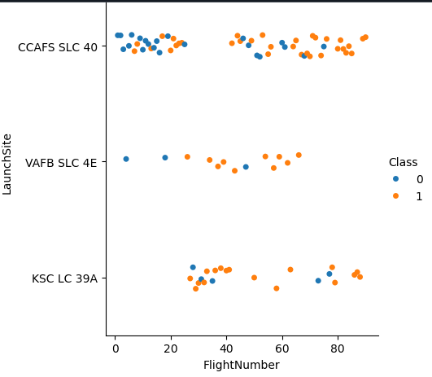
Flight Number vs. Launch Site
Here is a Scatter plot that shows the relationship between The FlightNumber and LaunchSite, Class
Insight: CCAFS SLC 40 has way more failures compared to the remaining Landing Sites. Also lower flight numbers have more failures

Slide 19
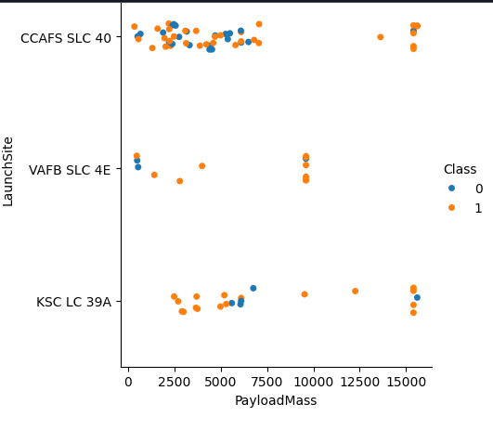
Payload vs. Launch Site
Here is a Scatter plot that shows the relationship between Payload and Launch Site, Class
If we observe Payload Mass Vs. Launch Site scatter point chart you will find for the VAFB-SLC launchsite there are no rockets launched for heavypayload mass(greater than 10000).

Slide 20
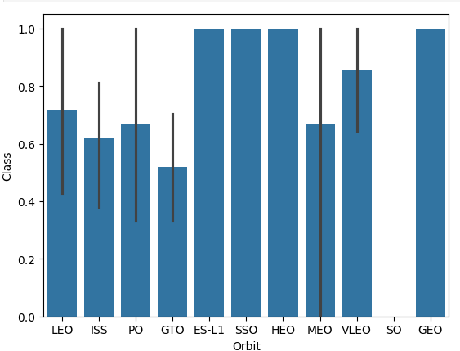
Success Rate vs. Orbit Type
Here is a bar chart for the success rate of each orbit type
We can see that ES-L1, SSO, HEO, GEO have the highest success rates.

Slide 21
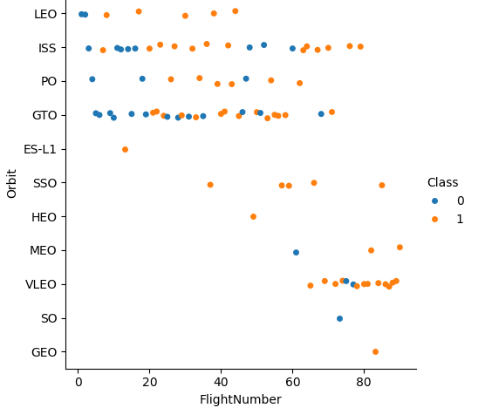
Flight Number vs. Orbit Type
Here is a Scatter plot for Flight number vs. Orbit type vs Class
We can observe that in the LEO orbit, success seems to be related to the number of flights. Conversely, in the GTO orbit, there appears to be no relationship between flight number and success.

Slide 22
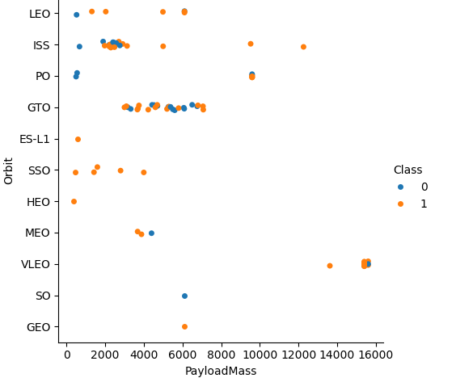
Payload vs. Orbit Type
Here is a scatter plot of payload vs. orbit type vs class
With heavy payloads the successful landing or positive landing rate are more for Polar,LEO and ISS.
However, for GTO, it's difficult to distinguish between successful and unsuccessful landings as both outcomes are present.

Slide 23
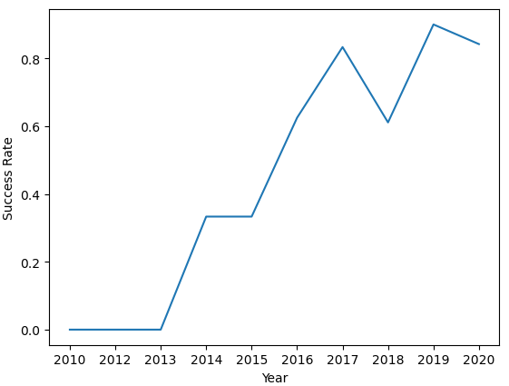
Launch Success Yearly Trend
Here is a line plot that shows the Success Rate over the years.
you can observe that the sucess rate since 2013 kept increasing till 2020

Slide 24
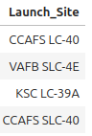
All Launch Site Names
Find the names of the unique launch sites
Query : select distinct "Launch_Site" from SPACEXTABLE;
The query uses distinct keyword to get unique values from the column Launch_Site.

Slide 25
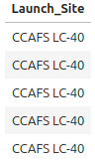
Launch Site Names Begin with 'CCA'
Find 5 records where launch sites begin with `CCA`
select "Launch_Site" from SPACEXTABLE
where "Launch_Site" like 'CCA%'
limit 5;
This query uses the where clause to filter the data that contains first 5 Launch_Sites that starts with CCA

Slide 26
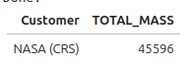
Total Payload Mass
Calculate the total payload carried by boosters from NASA
select Customer, sum(PAYLOAD_MASS__KG_) as TOTAL_MASS
from SPACEXTABLE
group by(Customer)
having Customer = 'NASA (CRS)';
To get the total payload mass from NASA, we need to perform a groupby with a sum() aggregate function. To filter the data to contain only NASA, use the having clause.

Slide 27
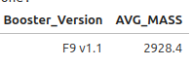
Average Payload Mass by F9 v1.1
Calculate the average payload mass carried by booster version F9 v1.1
select "Booster_Version", AVG(PAYLOAD_MASS__KG_) as AVG_MASS
from SPACEXTABLE
group by("Booster_Version")
having "Booster_Version" = 'F9 v1.1';
To get the average payload mass of F9 v1.1 booster we need to perform a groupby with a avg() aggregate function. To filter the data to contain only F9 v1.1, use the having clause.

Slide 28
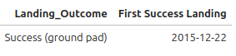
First Successful Ground Landing Date
Find the dates of the first successful landing outcome on ground pad
select "Landing_Outcome", min(date) as "First Success Landing" from SPACEXTABLE
where "Landing_Outcome" = 'Success (ground pad)';
We select the columns Landing_Outcome and date columns. We use the min function to find the first date. We filter the data that has only Successful Ground pad landing using the where clause.

Slide 29
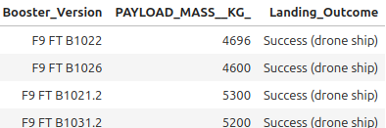
Successful Drone Ship Landing with Payload between 4000 and 6000
List the names of boosters which have successfully landed on drone ship and had payload mass greater than 4000 but less than 6000
select "Booster_Version", "PAYLOAD_MASS__KG_", "Landing_Outcome" from SPACEXTABLE
where "Landing_Outcome" = 'Success (drone ship)'
and "PAYLOAD_MASS__KG_" between 4000 and 6000;
We select the columns Booster_Verson, Payload_Mass_KG, Landing_Outcome columns. and we use where clause to get data that contains only Successful droneship Landing that has payload mass between 4000 and 6000

Slide 30
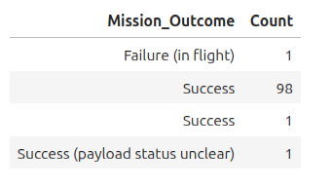
Total Number of Successful and Failure Mission Outcomes
Calculate the total number of successful and failure mission outcomes
select "Mission_Outcome", count("Mission_Outcome") "Count" from SPACEXTABLE
group by "Mission_Outcome";
For this query we are grouping the Mission_Outcome columns and we are using a count aggregate function to find the Success and failure missions.

Slide 31
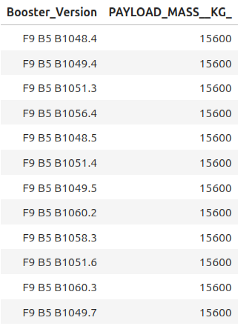
Boosters Carried Maximum Payload
List the names of the booster which have carried the maximum payload mass
select distinct "Booster_Version", "PAYLOAD_MASS__KG_" from SPACEXTABLE
where "PAYLOAD_MASS__KG_" = (
select max("PAYLOAD_MASS__KG_") from SPACEXTABLE
)
With this query we are using a sub query . First the internal query is using to get a max Payload_Mass_Kg_ column. then we can use that in the where clause of the main query. In there where cluase we are comparing if the Payload Mass column is equal to result of the sub query.

Slide 32
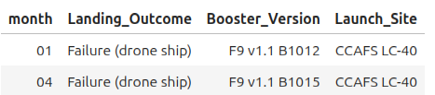
2015 Launch Records
List the failed landing_outcomes in drone ship, their booster versions, and launch site names for in year 2015
select substr(Date, 6,2) as month, "Landing_Outcome", "Booster_Version", "Launch_Site" from SPACEXTABLE
where "Landing_Outcome" = 'Failure (drone ship)' and substr(Date,0,5)='2015'
This query uses the where clause that checks if out Landing_Outcome is Failed Drone Ship and if the date is 2015. to grab the year, we are using the substr function.
The columns we are selecting month(using substring on the date ), Landing_Outcome, Booster_Version, Launch_Site.

Slide 33
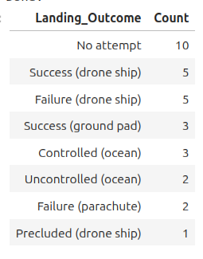
Rank Landing Outcomes Between 2010-06-04 and 2017-03-20
Rank the count of landing outcomes (such as Failure (drone ship) or Success (ground pad)) between the date 2010-06-04 and 2017-03-20, in descending order
select "Landing_Outcome", count("Landing_Outcome") as "Count"
from SPACEXTABLE
where Date between '2010-06-04' and '2017-03-20'
group by "Landing_Outcome"
order by "Count" desc;
In this query, we are using the columns Landing_Outcome, Count of the Landing_Outcome . To perform this we need to use the groupby on the landing_Outcome. We filter the data using the where clause which get only the data that contains Date between '2010-06-04' and '2017-03-20' . Finally we sort the data using the Count

Slide 34

Section 3

Slide 35
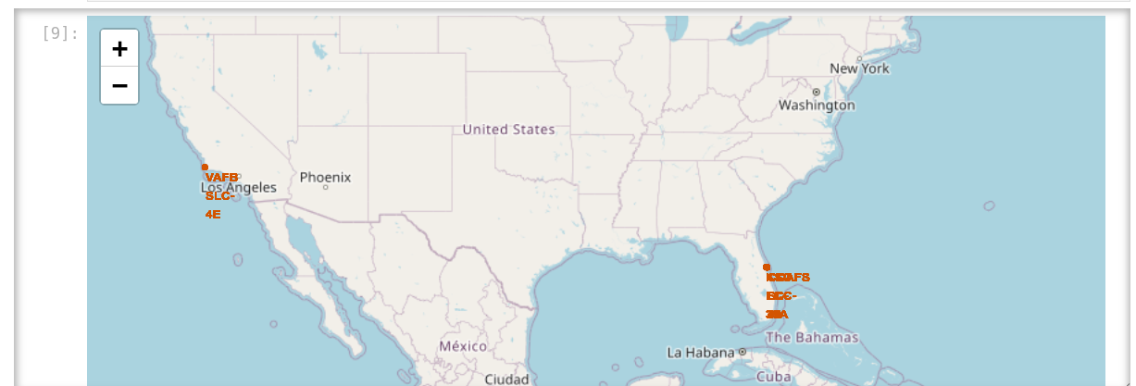
All Launch Sites markers on a Folium Map.
We can see that the launch sites are near the costal area

Slide 36
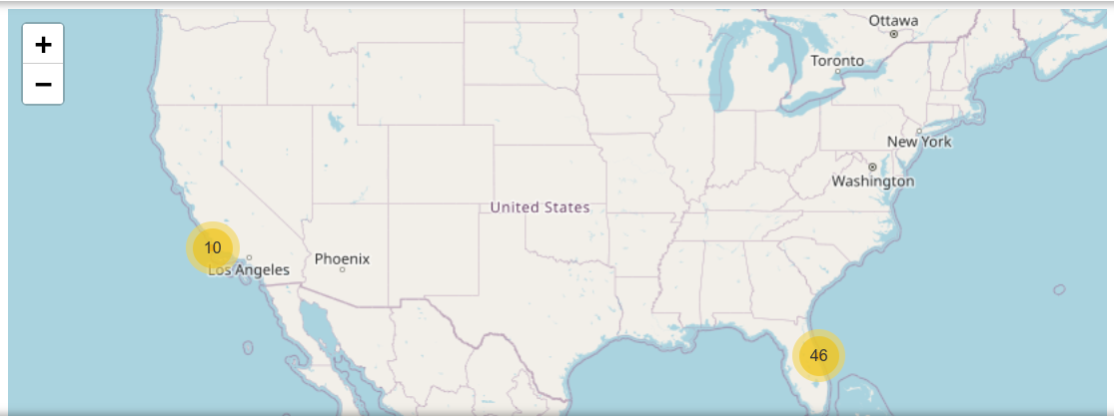
Folium Map with all Launch Sites with Marker Cluster
The marker clusters helps to cluster the markers in an area and shows us how many markers are in an area depending on the zoom level.

Slide 37
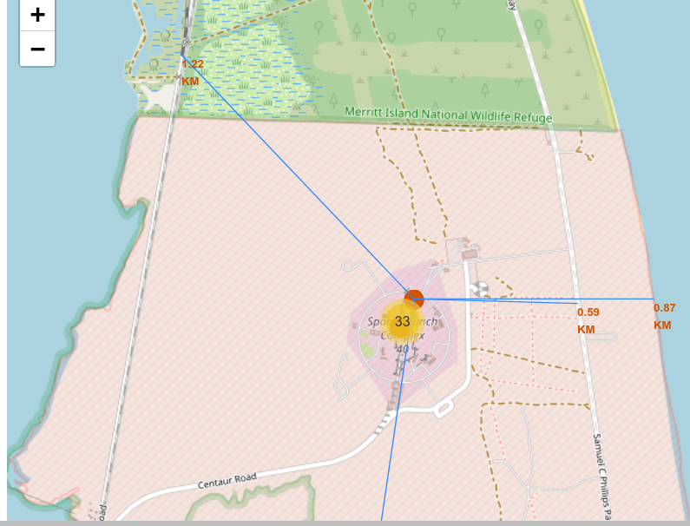
Marking distance of Launch Site from Highway, Railway Track, Coastline , City
Along with the marker cluster, we placed markers for a Higway, Rail Track , Coast line, City by using specific latitude and longitude.
We calculate distance between the marker and the launch site and use the distance as the marker text.
Then we use polyLines to draw the lines from the launch site to each marker.
We can see that The launch Site is close to roads, coastline, Railway but its far from the city.

Slide 38

Section 4

Slide 39
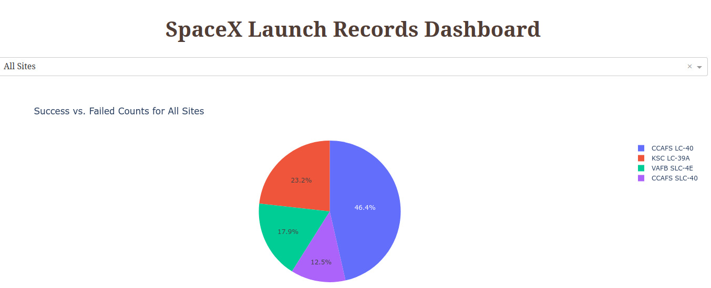
Dash App that shows the success rates of all the launch sites
To create this, we first setup a dropdown in the layout of the app and a callback function that captures its inputs. then based on the input provided, we use plotly exppress to create the pie chart.
From the pie char above CCAFS SLC-40 has the highest success rate among all launch Site with 46.4%

Slide 40
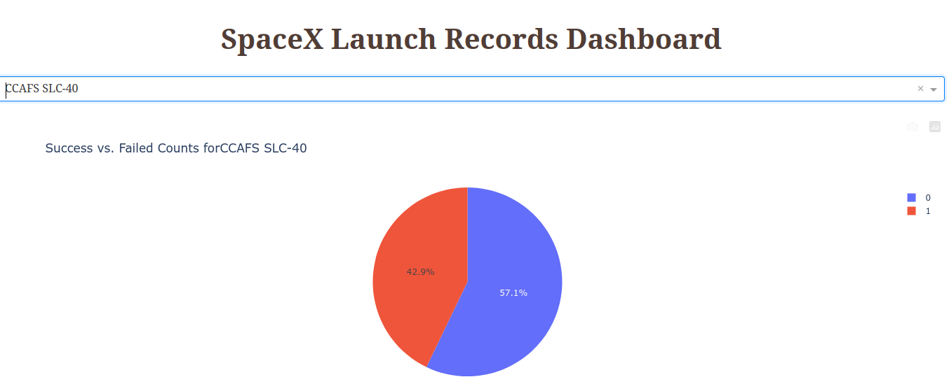
Pie chart that shows the Launch Site with the highest Success to failure ratio.
We can see that the to number of successful landing is almost the same as number of failures but there are more failures.

Slide 41
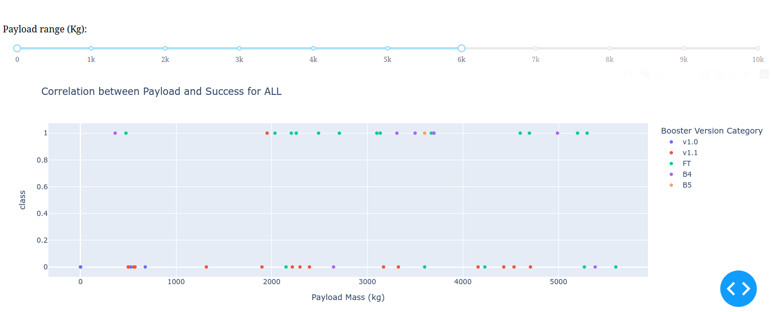
Scatter plot for Payload vs Success Rate
To create this, we started with a RangeSlider component. Then we used the range as input for the calback function. We use this for filtering the Payload Mass. The range selected above is (0- 6000)
We can see majority of the FT has class 1.

Slide 42

Section 5

Slide 43
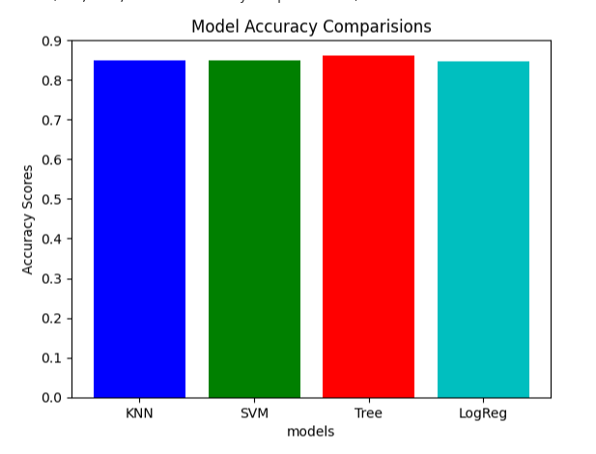
Classification Accuracy
We built 4 models with GridSearch for parameter tuning and we plotted the bars for the accuracies.
We can see that the Decision Tree has the highest accuracy score.

Slide 44
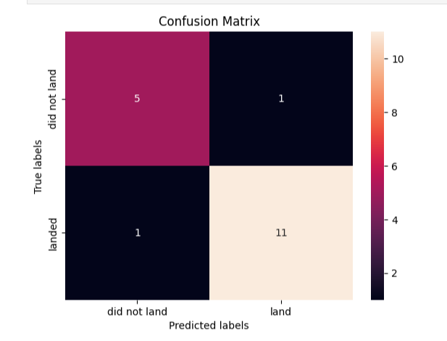
Confusion Matrix
This is the Confusion matrix for the Decision tree algorithm which has the best accuracy.
We can see the model has 16 Correct predictions and 2 wrong predictions. which reflects in the accuracy score (0.86) which is slightly higher than other models.

Slide 45
Conclusions
The first groud pad landing was on 2015-12-22.
CCAFS SLC-40 has 46% success rate.
CCAFS SLC-40 has higher Success Rate compared to the remaining Launch Sites.
VAFB-SLC launchsite has no rockets launched for heavy payload mass(greater than 10000).
ES-L1, SSO, HEO, GEO orbits have the highest success rates.
Decision Tree is the best model for this problem.

Slide 46
Appendix
Code Example for the training process:
X_train, X_test, Y_train, Y_test = train_test_split(X, Y, test_size = 0.2, random_state = 2)
parameters ={'C':[0.01,0.1,1], 'penalty':['l2'], 'solver':['lbfgs']}
parameters ={"C":[0.01,0.1,1],'penalty':['l2'], 'solver':['lbfgs']}# l1 lasso l2 ridge
lr=LogisticRegression()
logreg_cv = GridSearchCV(lr, cv = 10, param_grid = parameters )
logreg_cv.fit(X_train, Y_train)
print("tuned hpyerparameters :(best parameters) ",logreg_cv.best_params_)
print("accuracy :",logreg_cv.best_score_)

Slide 47


